Slide 1

MACHINE LEARNING DETECTION OF FOREST FIRES
Nile Coble Week 1 Review

Slide 2
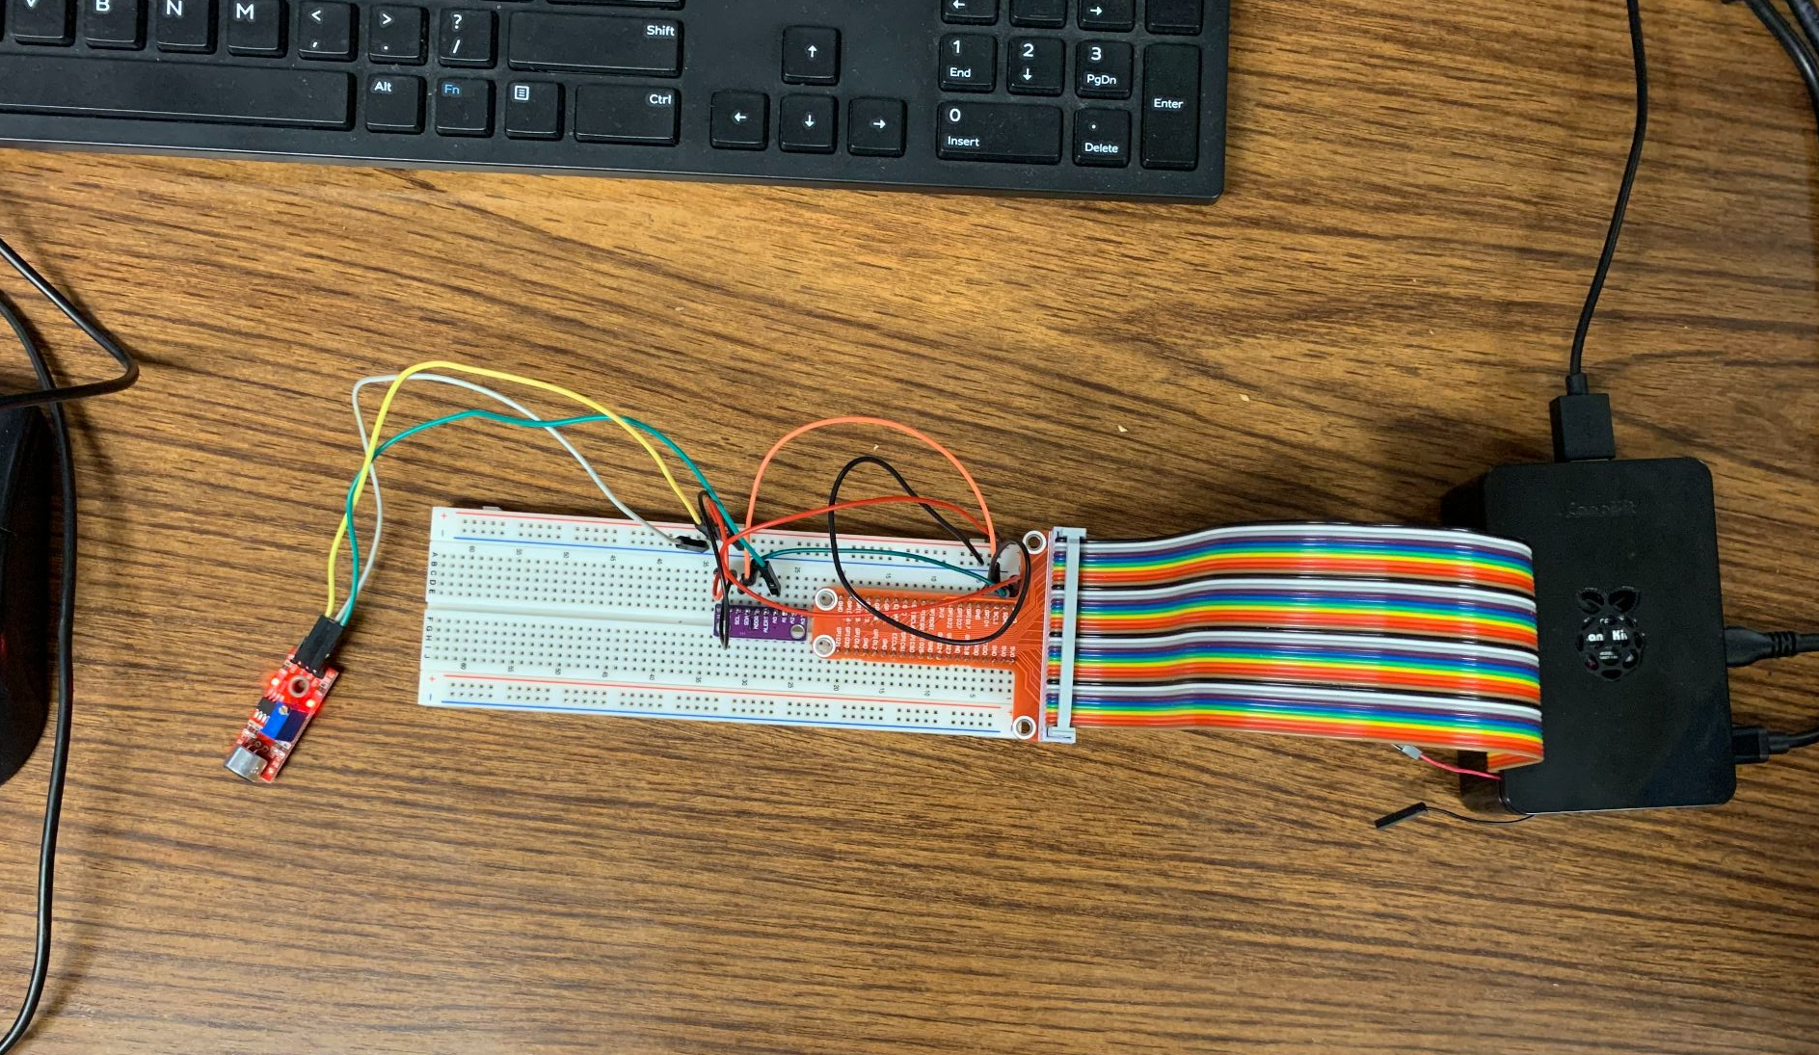
ADC ^
^ RPi pinout
<-- microphone
Raspberry Pi ^

Slide 3
Current state
Record for a given time and create a .wav file
Issues
Aliased to below 430 Hz
Small amount of unique mV values within range:
Min mV: 30448
Max mV: 31264
Range: 816
Unique values: 31

Slide 4
THANK YOU

